Slide 1

Child Abuse Prevention
PRESENTED BY
NATIONAL CHILDREN AND YOUTH SERVICES
July 24, 2026

Slide 2

Understanding Child Abuse
Definition of Child Abuse
Types of Abuse
Child abuse is defined as harm or the risk of harm to a child due to actions or inactions by a responsible adult, impacting their safety and well-being.
Child abuse encompasses physical, emotional, sexual abuse, and neglect. Each type can severely affect a child's development and mental health, requiring immediate attention.
Universal Risk
Abuse can occur in any family, regardless of socioeconomic status, education, or cultural background. Awareness and recognition are essential for effective prevention and intervention.

Slide 3

Risk Factors for Abuse
Financial Hardship
Substance Misuse
Financial difficulties can lead to increased stress, making families more vulnerable to conflict and potential abuse, affecting approximately 14% of U.S. families annually.
Substance misuse significantly raises the risk of child abuse, with studies showing that 30% of child maltreatment cases involve caregivers struggling with addiction.
Domestic Violence
Domestic violence and social isolation can heighten a child's vulnerability, with 15.5 million children exposed to domestic violence each year in the U.S.

Slide 4

Protective Factors for Families
Positive Social Connections
Stable Housing & Healthcare
Building strong social networks provides essential emotional and practical support, reducing stress and enhancing family resilience against potential abuse situations.
Access to stable housing and healthcare is critical for family well-being, ensuring children’s basic needs are met and reducing the risk of neglect and abuse.
Parenting Education
Engaging in parenting education fosters healthy family dynamics, equipping parents with skills to manage stress and promote positive interactions with their children.

Slide 5


Warning Signs of Abuse
Signs in Children
Behavioral Indicators
Children may exhibit unexplained injuries or sudden changes in behavior, such as extreme withdrawal or aggression, indicating potential distress or abuse.
Signs of withdrawal, aggression, or poor hygiene can suggest a child is experiencing abuse. Frequent absences from school may also be a red flag.
Adult Warning Signs
Adults may display excessive discipline, show little concern for a child's well-being, or isolate the child, which can indicate potential abuse.

Slide 6

Healthy Parenting Practices
Listening with Patience
Creating Consistent Routines
Active listening fosters open communication, allowing children to express feelings. Studies show that children who feel heard are more likely to develop self-esteem and resilience.
Establishing daily routines helps children feel secure and understand expectations. Research indicates that children thrive in environments with predictable structures and schedules.
Managing Stress Effectively
Healthy stress management techniques, such as mindfulness and exercise, are essential for parents. Lower stress levels positively impact parenting quality and children's emotional well-being.

Slide 7
Teaching Children About Safety
Body Ownership Awareness
Encouraging Assertiveness
Teach children that their body belongs to them, empowering them to understand personal boundaries and the importance of consent from an early age.
Encourage children to say 'No' to unsafe touch, reinforcing their right to protect themselves and fostering confidence in their ability to assert boundaries.
Identifying Safe Adults
Help children identify safe adults they can trust, ensuring they know who to turn to for help when they feel scared or uncomfortable.

Slide 8
Community Involvement
✓
Support Parents and Families
Engage with local families by offering resources and emotional support. Programs that assist with parenting skills can reduce stress and prevent potential abuse.
✓
Volunteer and Mentor
Become a mentor to children in your community. Volunteering in schools or youth programs provides guidance and positive role models, fostering a safe environment.
✓
Report Concerns Promptly
If you suspect child abuse, report it to local authorities immediately. Timely intervention can prevent further harm and ensure the child's safety.
✓
Promote Kindness
Encourage kindness in your community by organizing events that foster positive interactions. Safe environments help children feel valued and protected.

Slide 9

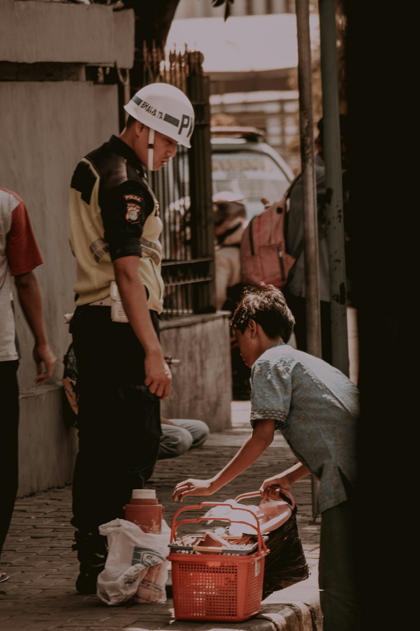

When to Seek Help
Contact Child Protective Services
Reach Out in Emergencies
Seek Professional Guidance
If you suspect a child is in danger, immediately contact local child protective services to ensure their safety and well-being.
In cases of immediate danger, contact local law enforcement to provide urgent assistance and protect the child from harm.
If unsure how to respond to a situation, consult with qualified professionals who can provide appropriate advice and support.

Slide 10
Key Takeaways
Child abuse prevention is a collective responsibility that requires awareness, education, and action from all community members. Recognizing warning signs, supporting families, and promoting healthy environments are crucial. By fostering strong relationships and providing resources, we can create a safer future for children. Let’s commit to being proactive in our communities, ensuring every child has the opportunity to thrive in a loving and secure environment.

