Slide 1


Positive Parenting: Building Strong Families
PRESENTED BY
NATIONAL CHILDREN AND YOUTH SERVICES
July 24, 2026
Made with SlideMaker.app

Slide 2




Positive Parenting: Building Strong Families
Positive parenting is a transformative approach that fosters healthy relationships between parents and children. It emphasizes love, respect, and guidance over punishment, creating a nurturing environment. This presentation explores the core principles of positive parenting, its benefits, and practical strategies for implementation. By focusing on emotional support and effective communication, parents can help their children develop essential life skills, resilience, and confidence. Join us in discovering how positive parenting can strengthen families and communities.
Made with SlideMaker.app

Slide 3




What is Positive Parenting?
Teaching Over Punishment
Warmth and Structure
Positive parenting emphasizes teaching and guiding children rather than relying on punishment, fostering a supportive environment for learning and growth.
This approach combines warmth, structure, and consistency, creating a safe space for children to thrive emotionally and socially.
Emotional Connections
Building strong emotional connections with children is essential, promoting love, respect, and mutual trust within the family unit.
Made with SlideMaker.app

Slide 4


Benefits of Positive Parenting
Children Feel Safe and Loved
Promotes Responsibility and Relationships
Improves Communication Skills
Positive parenting fosters a secure environment, enhancing children's self-esteem. Studies show that children who feel loved are 30% more likely to exhibit confidence.
Children learn responsibility through guidance, leading to healthier relationships. Research indicates that positive parenting increases social skills by 25% in children.
Effective communication is nurtured through positive parenting. Children develop emotional management skills, reducing behavioral issues by 40% in supportive environments.
Made with SlideMaker.app

Slide 5
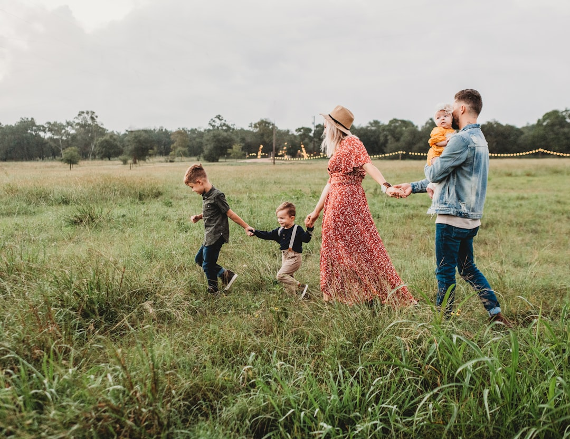
Five Foundations of Positive Parenting
Show Unconditional Love
Set Clear Expectations
Daily expressions of love, such as hugs and quality time, foster security. Children who feel loved are more likely to develop healthy self-esteem and resilience.
Establish simple, age-appropriate family rules. Consistent guidelines help children understand acceptable behavior, promoting a sense of safety and responsibility in their actions.
Listen Before Correcting
Listening without interruption builds trust. Acknowledge your child's feelings before addressing behavior, allowing them to feel understood and supported in their emotional experiences.
Made with SlideMaker.app

Slide 6



Encouraging Positive Behavior
Praise Specific Behaviors
Encourage Sharing and Kindness
Model Respectful Communication
Reinforce good behavior by praising specific actions. For example, say, 'I noticed how kind you were to your sister,' to encourage similar future behavior.
Promote sharing and helping among siblings. Create opportunities for cooperative play, which fosters empathy and strengthens family bonds through shared experiences.
Demonstrate respectful communication and problem-solving. Children learn by observing; use calm discussions to resolve conflicts and encourage open dialogue.
Made with SlideMaker.app

Slide 7



Helping Children Understand Feelings
Teach Emotion Naming
Model Healthy Expression
Encourage Open Conversations
Encourage children to identify and name their emotions, enhancing their emotional vocabulary. This practice fosters self-awareness and helps them articulate feelings effectively.
Demonstrate healthy emotional expression by sharing your feelings appropriately. Use coping strategies like deep breathing to show children how to manage emotions constructively.
Create a safe space for children to discuss their feelings. Regularly check in with them to promote open dialogue, reinforcing that all emotions are valid.
Made with SlideMaker.app

Slide 8

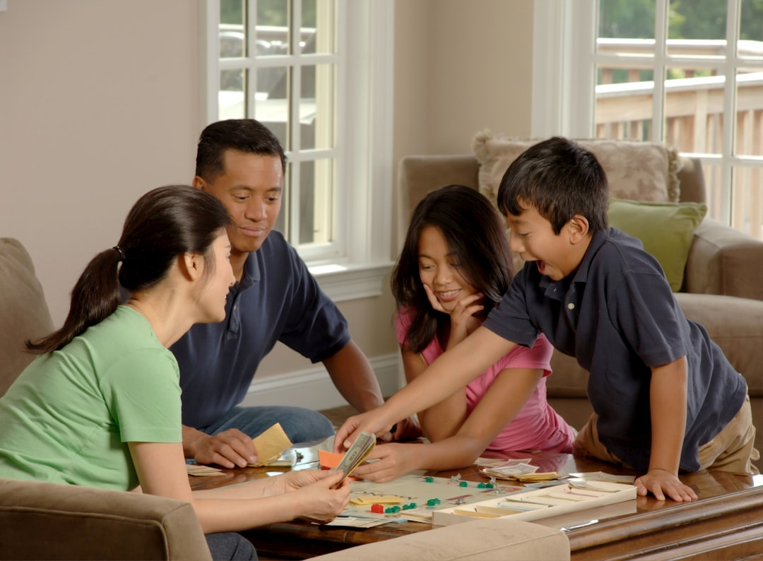

Building Strong Family Connections
Share Meals Together
Engage in Family Activities
Create Traditions and Celebrate
Regular family meals foster connection and communication. Studies show families who eat together have stronger relationships and improved emotional well-being.
Participating in activities like reading and games enhances bonding. These shared experiences promote teamwork and create lasting memories for all family members.
Establishing family traditions and celebrating milestones strengthens bonds. Rituals provide a sense of belonging and continuity, enhancing family identity and connection.
Made with SlideMaker.app

Slide 9
Effective Communication Strategies
Make Eye Contact
Listen Actively
Establishing eye contact fosters connection and shows children they are valued. This simple act encourages open dialogue and enhances understanding in conversations.
Active listening involves fully engaging with your child. Acknowledge their feelings and thoughts, which builds trust and encourages them to express themselves freely.
Speak Respectfully
Using respectful language sets a positive tone. Encourage questions and discussions, creating a safe space for children to share their ideas and concerns.
Made with SlideMaker.app

Slide 10
Taking Care of Yourself
•
Rest and Recharge
Prioritizing rest helps parents maintain energy levels. Studies show that adequate sleep improves mood and cognitive function, essential for effective parenting.
•
Eat Healthy Meals
Nutritious meals support overall well-being. A balanced diet rich in fruits, vegetables, and whole grains can enhance physical health and emotional resilience.
•
Stay Connected
Maintaining relationships with supportive friends and family reduces stress. Social connections can provide emotional support and practical help during challenging parenting moments.
•
Ask for Help
Seeking assistance when overwhelmed prevents burnout. Parents should feel empowered to reach out for help, whether from family, friends, or professional resources.
Made with SlideMaker.app

Slide 11




Key Takeaways
Positive parenting fosters strong family bonds and emotional resilience in children. By implementing strategies like unconditional love, clear expectations, and active listening, parents can nurture confident, responsible individuals. Moving forward, prioritize these practices to create a supportive environment that encourages growth and connection. Remember, every small effort contributes to building a brighter future for our children and communities.
Made with SlideMaker.app

