Slide 1


Understanding Childhood Trauma
PRESENTED BY
NATIONAL CHILDREN AND YOUTH SERVICES
July 24, 2026
Made with SlideMaker.app

Slide 2

Understanding Childhood Trauma
Childhood trauma significantly impacts a child's emotional and physical development. It can stem from various sources, including abuse, neglect, and loss. Recognizing the signs of trauma is crucial for caregivers and educators to provide the necessary support. This presentation aims to equip adults with knowledge and strategies to help children heal, grow, and thrive. By fostering safe environments and understanding trauma's effects, we can empower children to overcome their challenges and reach their full potential.
Made with SlideMaker.app

Slide 3

Understanding Childhood Trauma
Definition of Trauma
Impact on Development
Childhood trauma arises from overwhelming events that are frightening or harmful, impacting a child's emotional and psychological well-being significantly.
Trauma affects emotions, brain development, relationships, and learning, leading to long-term consequences if not addressed properly.
Varied Responses
Responses to trauma can differ greatly; two children may experience the same event but react in completely different ways, highlighting the need for individualized support.
Made with SlideMaker.app

Slide 4


Common Sources of Childhood Trauma
Types of Abuse
Neglect and Violence
Community and Environmental Factors
Children may face physical, emotional, or sexual abuse, which can lead to long-lasting psychological effects. Understanding these types is crucial for effective intervention.
Neglect, domestic violence, and loss of a loved one are significant trauma sources. These experiences can disrupt a child's sense of safety and stability.
Natural disasters, community violence, bullying, and chronic poverty contribute to trauma. Recognizing these factors is essential for supporting affected children.
Made with SlideMaker.app

Slide 5
Recognizing Signs of Trauma
Emotional Signs
Behavioral Signs
Children may exhibit emotional signs such as anxiety, mood swings, and low self-esteem, which can indicate underlying trauma and affect their daily interactions.
Behavioral manifestations of trauma can include aggression or withdrawal, making it crucial for caregivers to recognize these changes for timely intervention.
School-Related Signs
Declining grades and frequent absences are common school-related signs of trauma, highlighting the need for supportive educational environments to aid recovery.
Made with SlideMaker.app

Slide 6
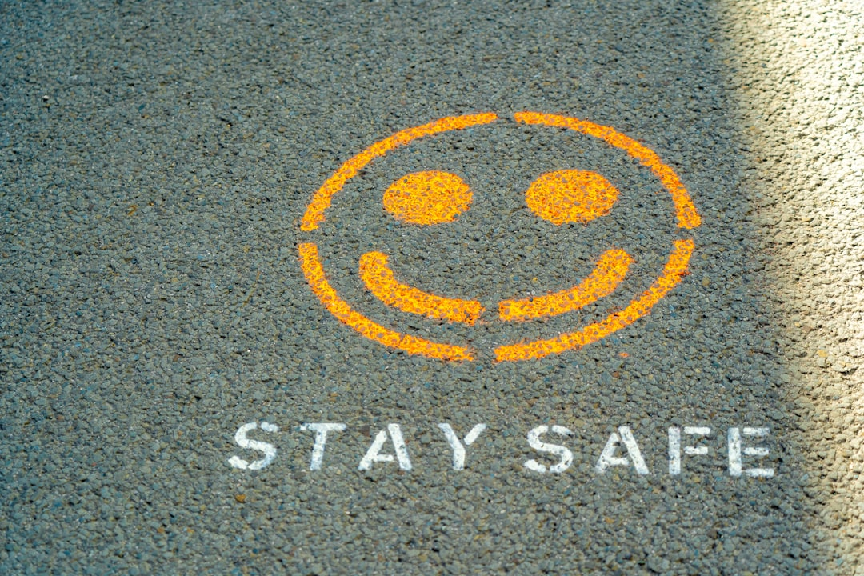


Supporting Healing in Children
Need for Safety
Importance of Predictability
Role of Healthy Relationships
Children require a safe environment to heal. Safety fosters emotional stability, allowing children to express themselves without fear, which is crucial for recovery.
Consistent routines provide children with a sense of security. Predictability helps them manage anxiety and fosters trust in their caregivers and surroundings.
Strong, supportive relationships with caring adults significantly impact a child's healing journey. These connections provide encouragement and hope, essential for emotional recovery.
Made with SlideMaker.app

Slide 7

Trauma-Informed Parenting Strategies
Stay Calm for Stability
Consistency in Routines
Children often mirror the emotional state of adults. Remaining calm helps provide a sense of safety, allowing children to process their feelings more effectively.
Establishing predictable routines fosters a sense of security. Children thrive when they know what to expect, which can reduce anxiety and promote emotional well-being.
Build Trust Through Reliability
Keeping promises and being dependable helps children feel secure. Trust is essential for healing, as it encourages open communication and emotional connection.
Made with SlideMaker.app

Slide 8
Building Resilience in Children
1
2
3
Encourage Healthy Relationships
Help Express Emotions
Promote Creative Activities
Fostering strong connections with peers and adults helps children feel secure, promoting emotional stability and resilience. Supportive relationships are crucial for recovery from trauma.
Teaching children to articulate their feelings builds confidence and emotional intelligence. This skill aids in processing trauma and enhances their ability to cope with challenges.
Engaging in sports or arts allows children to express themselves and develop problem-solving skills. These activities foster resilience by providing positive outlets for emotions.
Made with SlideMaker.app

Slide 9

When to Seek Help
1
Persistent Nightmares
Consult a mental health professional if a child experiences persistent nightmares, as this can indicate unresolved trauma and significantly impact their emotional well-being.
2
Signs of Self-Harm
Look for signs of self-harm or thoughts of suicide, which are critical indicators that a child may need immediate professional intervention to ensure their safety.
3
Behavioral Changes
Significant behavioral changes, such as extreme aggression or withdrawal, may require intervention. Early help can lead to improved long-term outcomes for affected children.
Made with SlideMaker.app

Slide 10
Caring for Caregivers
1
2
3
Importance of Rest
Seek Emotional Support
Maintain Healthy Routines
Caregivers must prioritize adequate rest to maintain their physical and mental health, ensuring they can effectively support children in their care.
Participating in support groups allows caregivers to share experiences and gain insights, fostering a sense of community and reducing feelings of isolation.
Establishing consistent routines not only models stability for children but also helps caregivers manage stress and create a nurturing environment.
Made with SlideMaker.app

Slide 11
Key Takeaways
Understanding childhood trauma is crucial for fostering resilience and healing. Caregivers and educators must prioritize safety, consistency, and emotional support. By recognizing trauma signs and responding compassionately, we can empower children to thrive. Let’s commit to creating nurturing environments that promote healing and hope for every child, ensuring they have the opportunity to reach their full potential.
Made with SlideMaker.app

