Slide 1

Understanding Human Trafficking
PRESENTED BY
NATIONAL CHILDREN AND YOUTH SERVICES
July 24, 2026
Made with SlideMaker.app

Slide 2

Ncys Community Education Series
The Ncys Community Education Series aims to raise awareness about human trafficking, a critical issue affecting children and youth across the United States. This presentation will explore the realities of trafficking, its warning signs, and the importance of community involvement in prevention. By educating families and empowering individuals, we can transform lives and create safer environments for our children. Awareness saves lives, and prevention begins with education.
Made with SlideMaker.app

Slide 3
Understanding Human Trafficking
Definition of Trafficking
Impact on Youth
Human trafficking exploits individuals through force, fraud, or coercion for labor or commercial sex, violating fundamental human rights and dignity.
Children and youth are particularly vulnerable, with many victims facing manipulation, threats, and violence, making awareness and education essential for prevention.
Geographic Scope
Trafficking is not limited to urban areas; it occurs in suburban and rural communities across the U.S., affecting diverse populations and backgrounds.
Made with SlideMaker.app

Slide 4

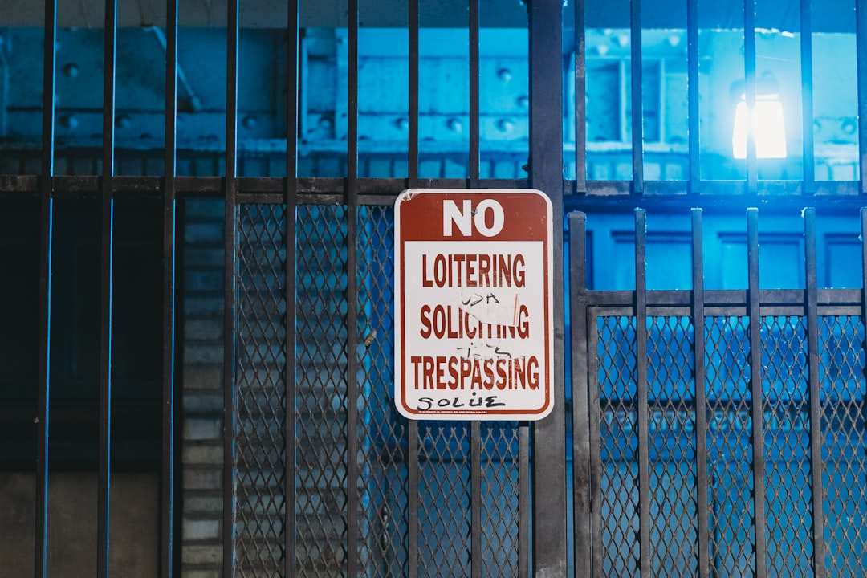
Types of Human Trafficking
Sex Trafficking Overview
Labor Trafficking Defined
Control Mechanisms
Sex trafficking involves the exploitation of individuals for commercial sexual activities, often using manipulation, threats, or violence to control victims.
Labor trafficking forces individuals to work under threats and manipulation, often in industries like agriculture, construction, and hospitality, impacting countless lives.
Victims may be controlled through violence, emotional dependence, or false promises, making it difficult for them to escape their situations.
Made with SlideMaker.app

Slide 5
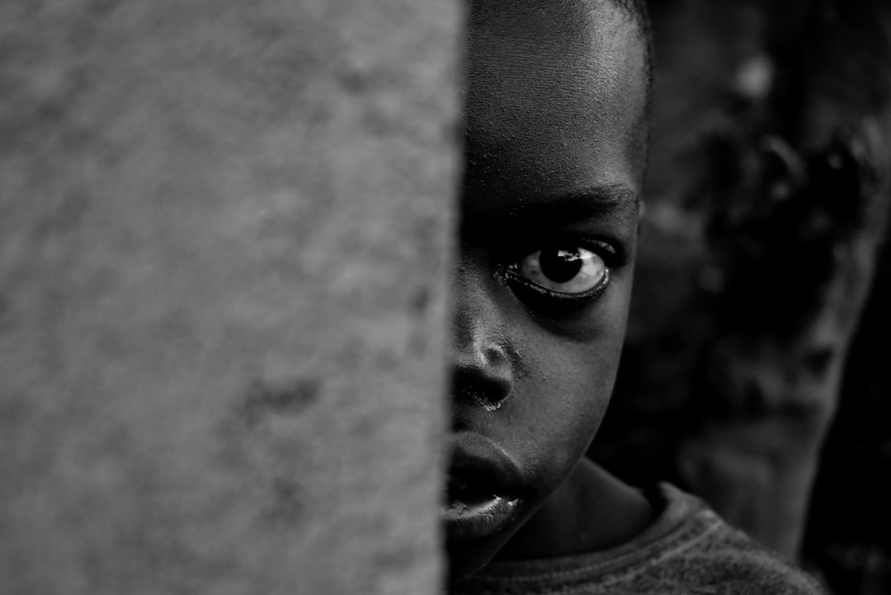
Who Is Most at Risk?
Children and Adolescents
Runaway or Homeless Youth
Children and adolescents are particularly vulnerable to trafficking, with studies showing that 1 in 7 runaways are likely to be approached by traffickers.
Runaway or homeless youth face increased risks of exploitation, as they often lack stable housing and support, making them easy targets for traffickers.
History of Abuse or Neglect
Individuals with a history of abuse or neglect are at higher risk, as trauma can lead to vulnerability and a lack of trust in adults.
Made with SlideMaker.app

Slide 6


Common Warning Signs
Sudden Wealth Indicators
Social Isolation
Signs of Fear or Anxiety
Victims may possess expensive items unexpectedly, raising concerns about their source. This can indicate exploitation or manipulation by traffickers.
A victim may become increasingly isolated from family and friends, which can be a tactic used by traffickers to exert control and limit support.
Victims often display fear, anxiety, or depression. These emotional states can indicate trauma and the presence of a controlling individual in their life.
Made with SlideMaker.app

Slide 7

Online Safety Matters
Traffickers Use Social Media
Keep Personal Information Private
Traffickers often exploit social media platforms to build trust with youth, making it crucial for parents to monitor online interactions and educate children about potential dangers.
Teach children the importance of keeping personal information private online, including their location, school, and contact details, to reduce vulnerability to exploitation.
Report Uncomfortable Conversations
Encourage children to report any uncomfortable conversations or interactions to trusted adults, fostering an environment where they feel safe discussing their online experiences.
Made with SlideMaker.app

Slide 8
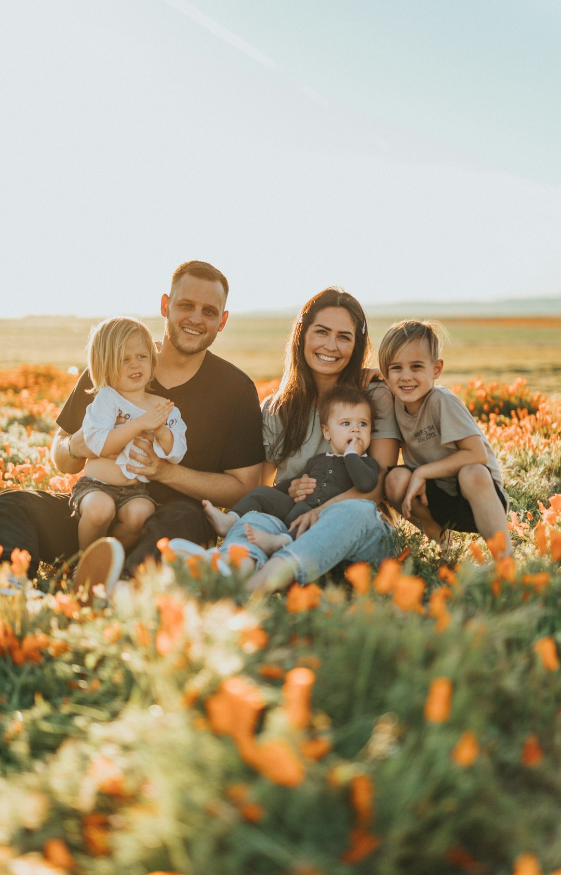


How Families Can Help
Build Trusting Relationships
Encourage Open Conversations
Stay Involved in Activities
Establish strong connections with your children by knowing their friends and fostering open communication. Trust is essential for children to share concerns about safety.
Discuss safety and boundaries regularly. Teach children to express their feelings and concerns, ensuring they feel comfortable approaching you about any issues.
Engage in school and community events to better understand your child's environment. Active participation helps build a support network and strengthens family bonds.
Made with SlideMaker.app

Slide 9
Myths and Facts About Trafficking
Myth: Trafficking Abroad Only
Myth: Victims Escape Easily
Many believe human trafficking is limited to foreign countries. In reality, it occurs across the U.S., affecting urban, suburban, and rural communities alike.
Contrary to popular belief, many victims do not escape due to fear, manipulation, or trauma. Their situations often involve complex psychological factors.
Myth: Only Girls Are Victims
Human trafficking impacts individuals of all genders and ages. Both boys and girls can be victims, highlighting the need for comprehensive awareness and prevention.
Made with SlideMaker.app

Slide 10
Building Safe Communities
Support Families
Expand Mentoring Opportunities
Increase Youth Engagement
Communities can reduce vulnerability by providing resources and support systems for families, ensuring they have access to essential services and a stable environment.
Creating mentorship programs can foster positive relationships, helping at-risk youth develop skills and resilience, ultimately reducing their chances of becoming victims.
Engaging youth in community activities promotes a sense of belonging and purpose, which can deter them from risky behaviors and potential exploitation.
Made with SlideMaker.app

Slide 11
Key Takeaways
Human trafficking is a pervasive issue affecting communities nationwide. Awareness, education, and open communication are vital in prevention. Families must recognize warning signs and engage in proactive measures. Together, we can create safer environments for children and youth, ensuring they live free from exploitation. Let’s commit to being informed advocates and support systems, fostering resilience and hope in our communities.
Made with SlideMaker.app

